Slide 1
Responsive portfolio
Author:G.Parkavi
Course:B.Sc.Computer Science
Date:04.09.2025

Slide 2
Problem statement
Many student and professional face challenges in showcasting they skill project and achievement effectively a digital portfolio provides and organised and creative way to press and wants profile beyond a traditional resume

Slide 3
Project overview
This project focus on developing a interview portfolio website I use HTML cs and JavaScript it high light personally details skill project and contain information with engaging design and animation

Slide 4
End users
The primary user are students job speaker and professional who went to present that are technical skill and achievement online to recrutiers, interviewers, and collaborators

Slide 5
Tools and technologies
The portfolio is built using HTML for structure CSS for styling and animations and JavaScript for interactive these technologies ensure responsiveness and an engaging user experience

Slide 6
Protfolio designs and layout
The layout is simple modern and user friendly consisting of sections like About Me Skills Projects and Content Smooth negative and animations enhance visual appeal and readabolity

Slide 7
Features and functionality
The portifolio includes responsive designs, animated effects, interactive navigation, project showcases, and a contact section. It is accessible across device and browers

Slide 8
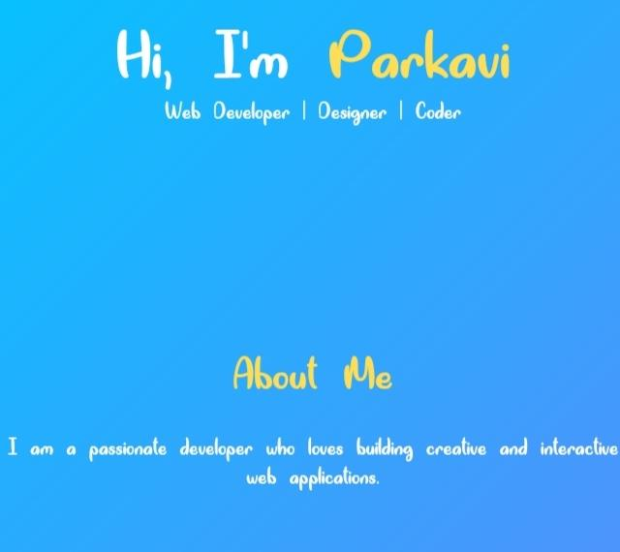
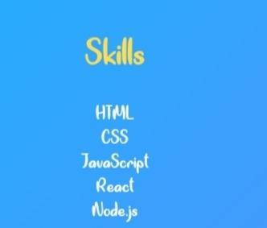
Results and screenshorts

Slide 9
Conclusion
This Project demonstrates how a personal portfolio website can effectively represent one's skills and projects. It servers as a professional tool for career growth and digital presence

Slide 10
Github linka
https://github.com/rab42731-create/Parkavi/tree/main

